Slide 1
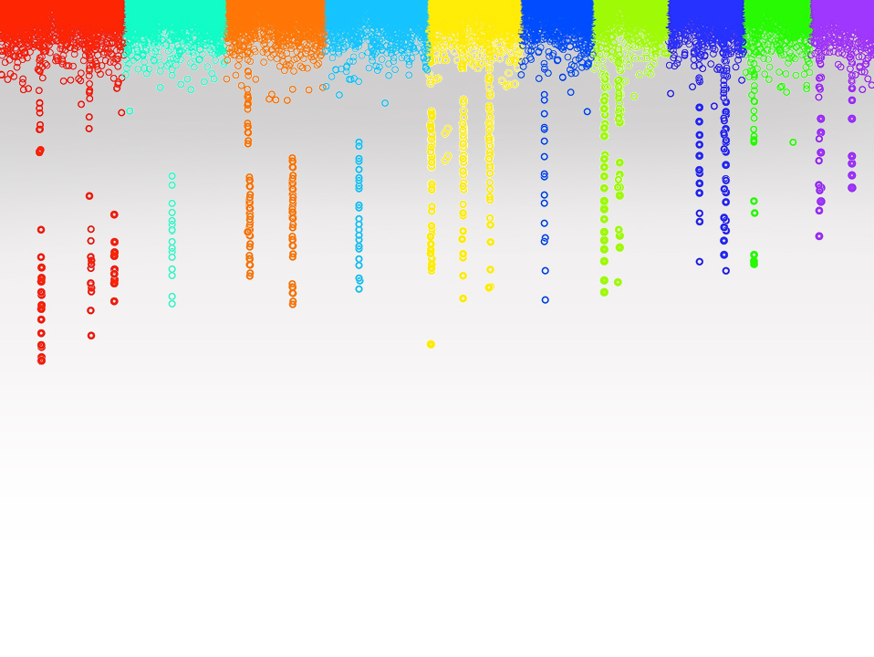

Statistical Genomics
Lecture 9: Genetic architecture and
simulation of phenotype
Zhiwu Zhang
Washington State University

Slide 2
Outline
Accumulation of gene effect
Genetic architecture
Gene effect distribution
Phenotype distribution
Heritability
R function

Slide 3
How phenotypes get normal distributed?
x~B(n, p)
n trials each with p successful rate.
The total number of successes is a random variable, x
p=0.5,
Left-fail
Right-success
x=rbinom(10000,5,0.5)
1
Gene 1
Gene 2
1
2
1
Gene 3
1
3
3
1
Gene 4
1
4
6
4
1
Gene 5
1
5
10
10
5
1
Even genes have the same effect
0
1
2
3
4
5
Outcome

Slide 4
Ten gens with same effect (unit=1)
individual=10000
gene=10
x=rbinom(n=individuals,m=gene,.5)
hist(x)

Slide 5
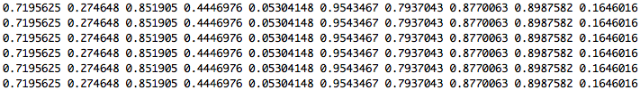
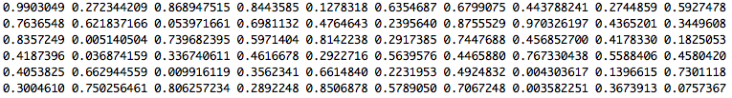
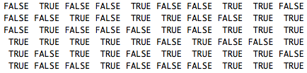
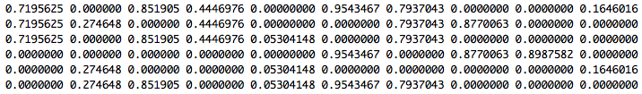
Ten gens with different effect (0~1)
Gene effect
Assign to six individuals
Uniform random variable
< 0.5?
Gene effects among the six individuals
SUM
Individuals' total effect

Slide 6
Ten gens with different effects
#x=rep(1,m)
x=runif(m)
gene=matrix(x,n,m,byrow = T)
head(gene)
galton=matrix(runif(n*m),n,m)
head(galton)
galton.binary=galton<.5
head(galton.binary)
gene[galton.binary]=0
head(gene)
y=rowSums(gene)
y[1:6]
hist(y)
plot(density(y))

Slide 7
Ten gens with different effects

Slide 8
10 genes
100 genes
Same effect
Different effects

Slide 9
Complex traits
Controlled by multiple genes
Influenced by environment
Also known as quantitative traits
Most traits are continuous, e.g. yield and height,
Some are categorical, e.g. node number, score of disease resistance
Some binary traits are still quantitative traits, e.g. diabetes
Economically important

Slide 10
Dissecting phenotype
Y= G + E + GxE + Residual
G = Additive + Dominance + Epistasis
E: Environment, e.g. year and location
Residual: e.g. measurement error

Slide 11
QTL and QTN
Quantitative Trait Loci (QTL)
Specific regions in the genome that are associated with quantitative traits
The regions were traditionally considered as 10-15 cM. The regions evolved to 3-5 cM in fine mapping.
Suppose maize genome contains 50,000 genes and has genetic map =1700 cM
Each QTL we identify has roughly 100-150 genes
Gene cloning: identification the QTL regions at gene level
Ultimate goal: functional mutations
Quantitative Trait Nucleotide: QTN

Slide 12
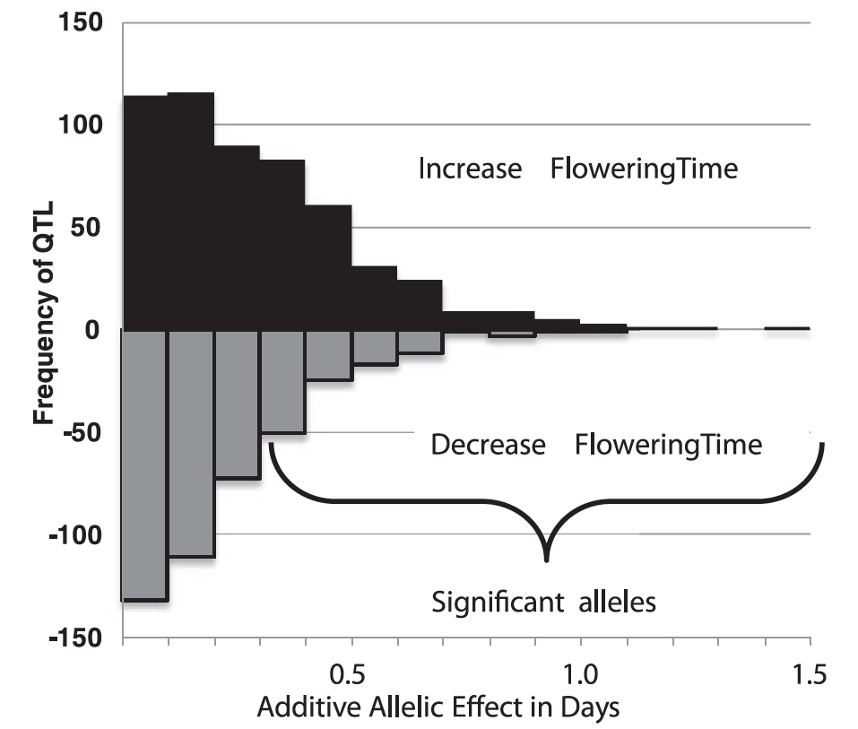
Gene effects
Flowering time is controled by >50 genes
Most have small effects
The largest one only 1.5 increase days
Buckler et al, Science, 2009

Slide 13
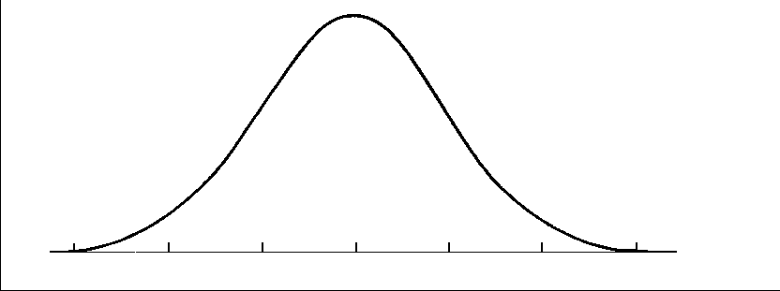
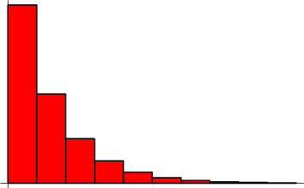
Distribution of QTN effect
Normal distribution
Geometry distribution

Slide 14
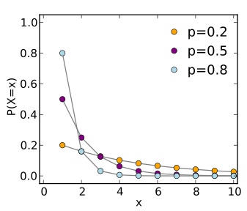
Theoretical geometric distribution
The probability distribution of the number (X) of Bernoulli trials needed to get one success
Prob (X=k)=(1-p)^{k-1} p

Slide 15
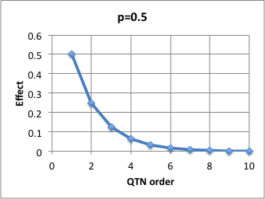
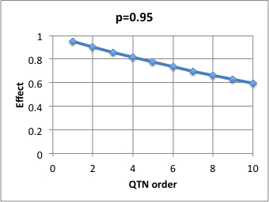
Approximated geometric distribution
Effect(X=k)=p^{k}
Effect of k^{th} QTN

Slide 16
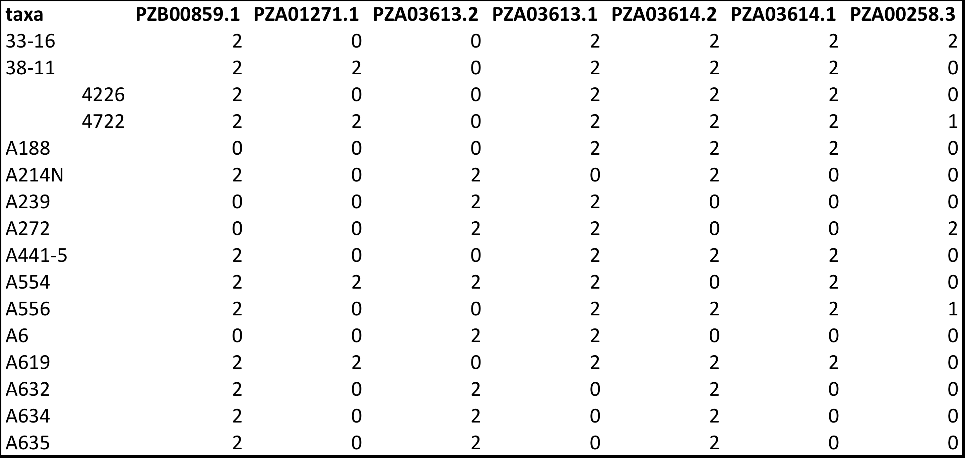
Genotype in Numeric format
myGD=read.table(file="http://zzlab.net/GAPIT/data/mdp_numeric.txt",head=T)

Slide 17
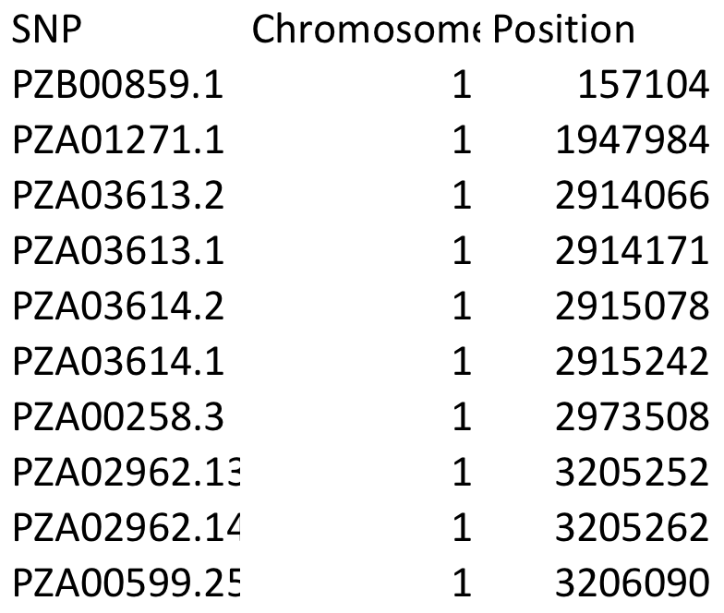
Genetic map
myGM=read.table(file="http://zzlab.net/GAPIT/data/mdp_SNP_information.txt",head=T)

Slide 18
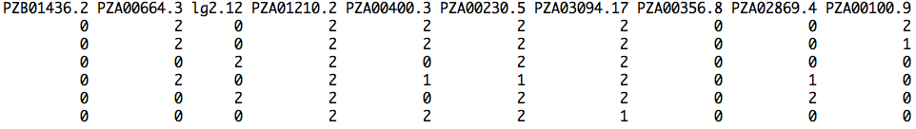
Sampling QTNs
#Sampling QTN
NQTN=10
X=myGD[,-1]
n=nrow(X)
m=ncol(X)
QTN.position=sample(m,NQTN,replace=F)
SNPQ=as.matrix(X[,QTN.position])
QTN.position
head(SNPQ)

Slide 19
QTN positions
plot(myGM[,c(2,3)])
lines(myGM[QTN.position,c(2,3)],type="p",col="red")
points(myGM[QTN.position,c(2,3)],type="p",col="blue",cex = 5)

Slide 20
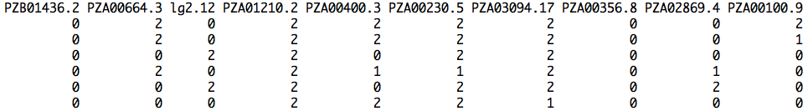
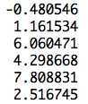
Additive genetic effect
addeffect=rnorm(NQTN,0,1)
addeffect
effect=SNPQ%*%addeffect
head(effect)

Slide 21
genetic effect distribution
par(mfrow=c(2,2))
plot(effect)
hist(effect)
boxplot(effect)
plot(ecdf(effect))

Slide 22
Phenotype = genetic + residual
y1 = g1 + e1
y2 = g2 + e2
y3 = g3 + e3
y4 = g4 + e4
y5 = g5 + e5
y6 = g6 + e6
…
Var(g): Calculated variance among individuals genetic effects
Var(g)
h²= --------------------------------------
Var(g) + Var(e)
y = g + e
Var(e) =(Var(g) - Var(g) h² ) / h²

Slide 23
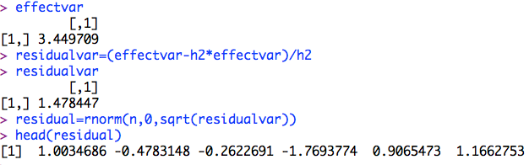
Residual
h2=.7
effectvar=var(effect )
effectvar
residualvar=(effectvar-h2*effectvar)/h2
residualvar
residual=rnorm(n,0,sqrt(residualvar))
head(residual)

Slide 24
Residual distribution
par(mfrow=c(2,2))
plot(residual)
hist(residual)
boxplot(residual)
plot(ecdf(residual))

Slide 25
Phenotype
y=effect+residual
par(mfrow=c(2,2))
plot(y)
hist(y)
boxplot(y)
plot(ecdf(y))

Slide 26
Heritability
va=var(effect)
ve=var(residual)
vp=var(y)
v=matrix(c(va,ve,vp),1,3)
colnames(v)=c("A", "E","P")
barplot(v,col="gray")
plot(density(y),ylim=c(0,.5))
lines(density(effect),col="blue")
lines(density(residual),col="red")

Slide 27
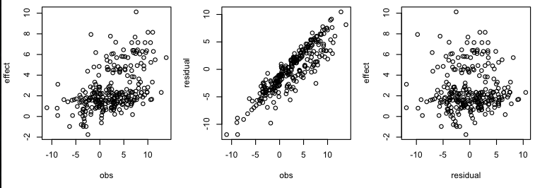
Correlations
#Plot
par(mfrow=c(1,3),mar = c(30,4,10,1))
plot(y,effect)
plot(y,residual)
plot(residual,effect)
cor(y,effect)

Slide 28
How to do this again and again?
Function

Slide 29
Function to simulate phenotypes
G2P=function(X,h2,alpha,NQTN,distribution){
n=nrow(X)
m=ncol(X)
#Sampling QTN
QTN.position=sample(m,NQTN,replace=F)
SNPQ=as.matrix(X[,QTN.position])
QTN.position
#QTN effects
if(distribution=="norm")
{addeffect=rnorm(NQTN,0,1)
}else
{addeffect=alpha^(1:NQTN)}
#Simulate phenotype
effect=SNPQ%*%addeffect
effectvar=var(effect)
residualvar=(effectvar-h2*effectvar)/h2
residual=rnorm(n,0,sqrt(residualvar))
y=effect+residual
return(list(addeffect = addeffect, y=y, add = effect, residual = residual, QTN.position=QTN.position, SNPQ=SNPQ))
}

Slide 30
Load R function
source('~/Dropbox/Current/ZZLab/WSUCourse/CROPS545/Demo/G2P.R')

Slide 31
source('~/Dropbox/Current/ZZLab/WSUCourse/CROPS545/Demo/G2P.R')
par(mfrow=c(3,1),mar = c(3,4,1,1))
myG2P=G2P(X,.75,1,10,"norm")
str(myG2P)
va=var(myG2P$add)
ve=var(myG2P$residual)
vp=var(myG2P$y)
v=matrix(c(va,ve,vp),1,3)
colnames(v)=c("A", "E","P")
barplot(v,col="gray")
myG2P=G2P(X,.5,1,10,"norm")
va=var(myG2P$add)
ve=var(myG2P$residual)
vp=var(myG2P$y)
v=matrix(c(va,ve,vp),1,3)
colnames(v)=c("A", "E","P")
barplot(v,col="gray")
myG2P=G2P(X,.25,1,10,"norm")
va=var(myG2P$add)
ve=var(myG2P$residual)
vp=var(myG2P$y)
v=matrix(c(va,ve,vp),1,3)
colnames(v)=c("A", "E","P")
barplot(v,col="gray")
va decreases with decreasing h2

Slide 32
Effect of Number of Genes
#Desect phenotype
par(mfrow=c(3,1))
myG2P=G2P(X,.5,1,2,"norm")
plot(density(myG2P$y),ylim=c(0,1.5))
lines(density(myG2P$add),col="blue")
lines(density(myG2P$residual),col="red")
myG2P=G2P(X,.5,1,10,"norm")
plot(density(myG2P$y),ylim=c(0,.3))
lines(density(myG2P$add),col="blue")
lines(density(myG2P$residual),col="red")
myG2P=G2P(X,.5,1,100,"norm")
plot(density(myG2P$y),ylim=c(0,.1))
lines(density(myG2P$add),col="blue")
lines(density(myG2P$residual),col="red")

Slide 33
Effect of Number of Genes
#Check on distribution
par(mfrow=c(3,3),mar = c(3,4,1,1))
myG2P=G2P(X,.5,1,2,"norm")
hist(myG2P$add)
hist(myG2P$residual)
hist(myG2P$y)
myG2P=G2P(X,.5,1,10,"norm")
hist(myG2P$add)
hist(myG2P$residual)
hist(myG2P$y)
myG2P=G2P(X,.5,1,100,"norm")
hist(myG2P$add)
hist(myG2P$residual)
hist(myG2P$y)

Slide 34
Check on gene effect distribution
#Check gene effect distribution
par(mfrow=c(3,3),mar = c(3,4,1,1))
myG2P=G2P(X,.5,1,10,"geom")
hist(myG2P$add)
hist(myG2P$residual)
hist(myG2P$y)
myG2P=G2P(X,.5,.95,10,"geom")
hist(myG2P$add)
hist(myG2P$residual)
hist(myG2P$y)
myG2P=G2P(X,.5,.5,10,"geom")
hist(myG2P$add)
hist(myG2P$residual)
hist(myG2P$y)

Slide 35
Highlight
Accumulation of gene effect
Genetic architecture
Gene effect distribution
Phenotype distribution
Heritability
R function

